Slide 1
Inference in Normal Regression Model
Dr. Frank Wood
TexPoint fonts used in EMF.
Read the TexPoint manual before you delete this box.: AAAAAAAAAA

Slide 2
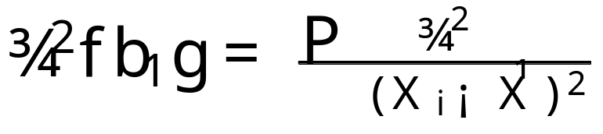
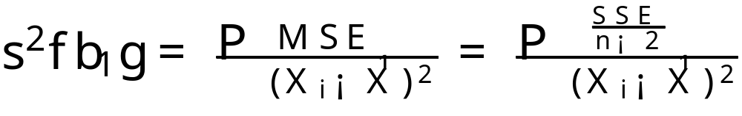
Remember
Last class we derived the sampling variance of the estimator of the slope, it being
And we made the point that an estimate of ¾²{b₁} could be arrived at by substituting the MSE for the unknown error variance.

Slide 3
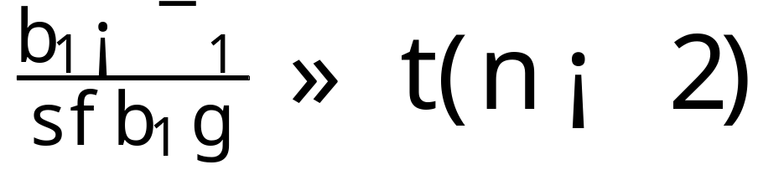

Sampling Distribution of (b₁ - ¯₁)/s{b₁}
We determined that b₁ is normally distributed so (b₁-¯₁)/¾{b₁} is a standard normal variable
We don’t know ¾²{b₁} so it must be estimated from data. We have already denoted it’s estimate s{b₁}
Using this estimate we it can be shown that

Slide 4
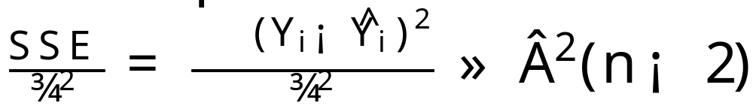
Where does this come from?
We need to rely upon the following theorem
  For the normal error regression model
  and is independent of b₀ and b₁
Intuitively this follows the standard result for the sum of squared normal random variables
  Here there are two linear constraints imposed by the regression parameter estimation that each reduce the number of degrees of freedom by one.

Slide 5
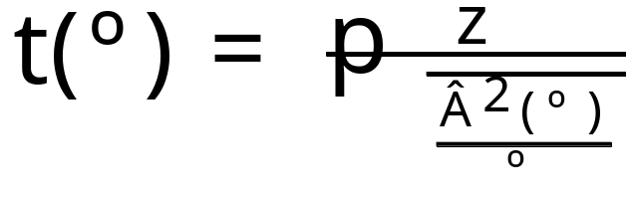
Another useful fact : t distribution
Let z and Â²(º) be independent random variables (standard normal (N(0,1)) and Â² respectively). We then define a t random variable as follows:
This version of the t distribution has one parameter, the degrees of freedom º

Slide 6
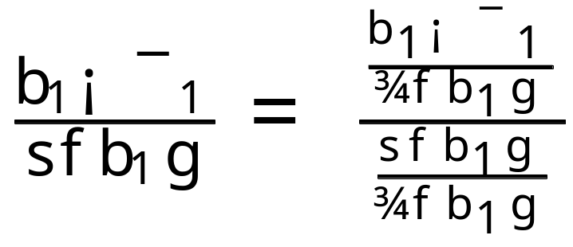
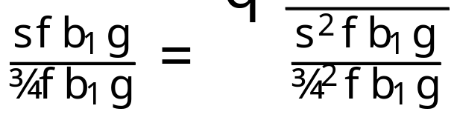
Distribution of the studentized statistic
To derive the distribution of this statistic using the provided theorems, first we do the following rewrite
The numerator
is a N(0,1)
normal variable

Slide 7
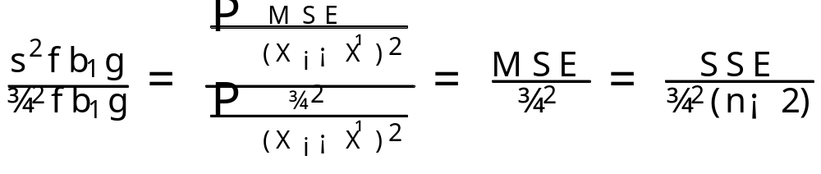
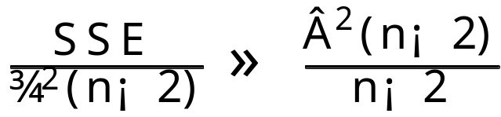
Studentized statistic cont.
And note the following
where we know (by the given theorem) the distribution of the last term is Â² and indep. of b₁ and b₀

Slide 8
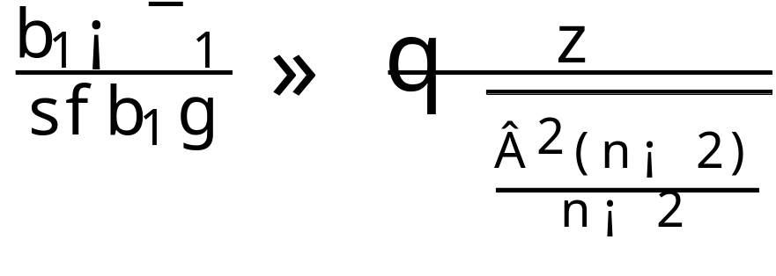
Studentized statistic final
But by the given definition of the t distribution we have our result
because putting everything together we can see that

Slide 9
Confidence Intervals and Hypothesis Tests
Now that we know the sampling distribution of b₁ (t with n-2 degrees of freedom) we can construct confidence intervals and hypothesis tests easily

Slide 10
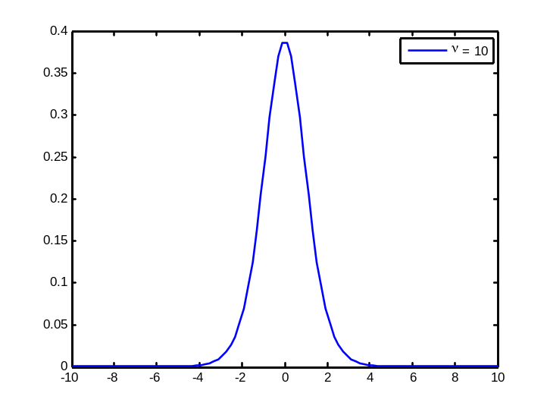
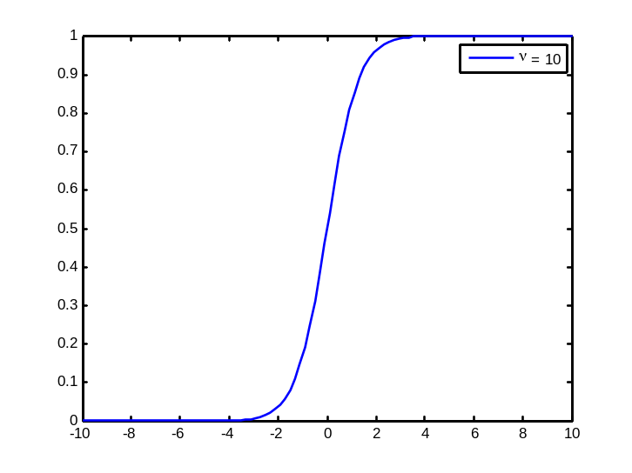
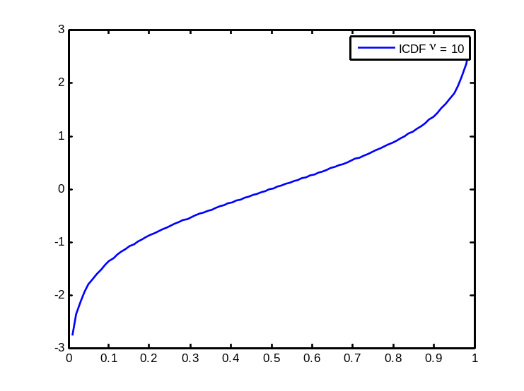
Confidence Interval for ¯₁
Since the “studentized” statistic follows a t distribution we can make the following probability statement

Slide 11
Interval arriving from picking ®
Note that by symmetry
Rearranging terms and using this fact we have
And now we can use a table to look up and produce confidence intervals

Slide 12
Using tables for Computing Intervals
The tables in the book (table B.2 in the appendix) for t(1-®/2;º) where
  P{t(º) · t(1-®/2; º)} = A
Provides the inverse CDF of the t-distribution
This can be arrived at computationally as well
  Matlab: tinv(1-®/2, º)

Slide 13

1-® confidence limits for ¯₁
The 1-® confidence limits for ¯₁ are
Note that this quantity can be used to calculate confidence intervals given n and ®.
  Fixing ® can guide the choice of sample size if a particular confidence interval is desired
  Give a sample size, vice versa.
Also useful for hypothesis testing
Show demo.m

Slide 14
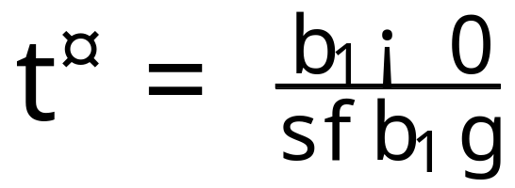
Tests Concerning ¯₁
Example 1
  Two-sided test
    H₀ : ¯₁ = 0
    H_{a} : ¯₁ ≠ 0
    Test statistic

Slide 15
Tests Concerning ¯₁
We have an estimate of the sampling distribution of b₁ from the data.
If the null hypothesis holds then the b₁ estimate coming from the data should be within the 95% confidence interval of the sampling distribution centered at 0 (in this case)

Slide 16
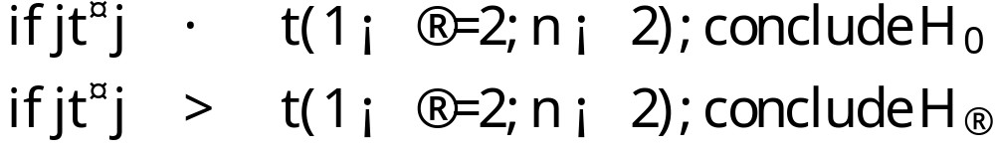
Decision rules
Absolute values make the test two-sided

Slide 17
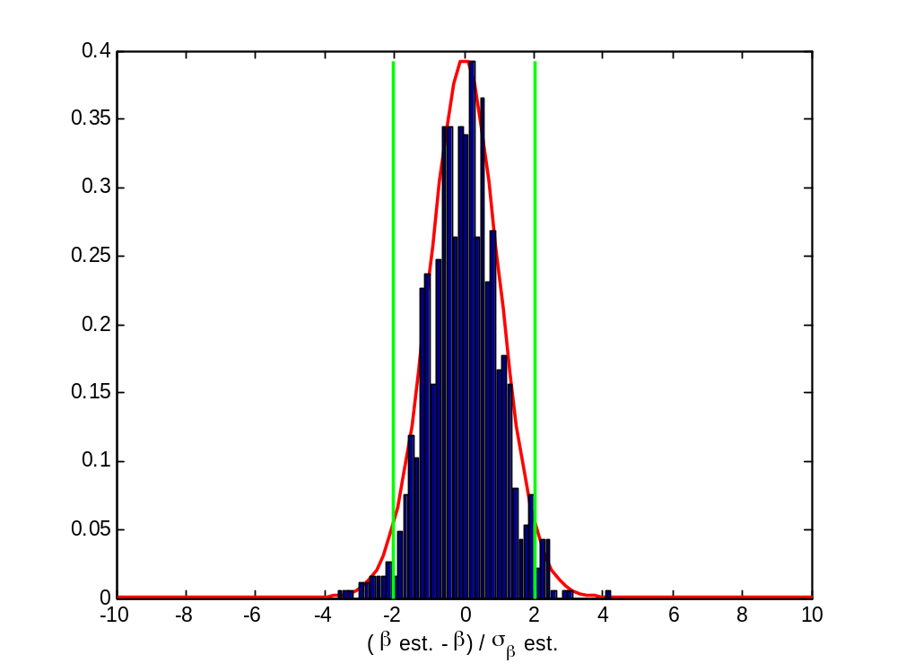
Intuition
1-® confidence interval
Test statistic
p-value is value of ®
that moves the green line
to the blue line

Slide 18
Calculating the p-value
The p-value, or attained significance level, is the smallest level of significance ® for which the observed data indicate that the null hypothesis should be rejected.
This can be looked up using the CDF of the test statistic.
In Matlab
  Two-sided p-value
    2*(1-tcdf(|t*|,º))

Slide 19

Inferences Concerning ¯₀
Largely, inference procedures regarding ¯₀ can be performed in the same way as those for ¯₁
Remember the point estimator b₀ for ¯₀

Slide 20
Sampling distribution of b₀
The sampling distribution of b₀ refers to the different values of b₀ that would be obtained with repeated sampling when the levels of the predictor variable X are held constant from sample to sample.
For the normal regression model the sampling distribution of b₀ is normal

Slide 21
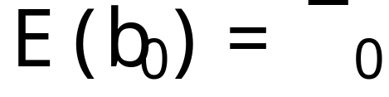
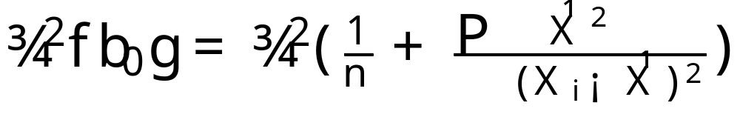
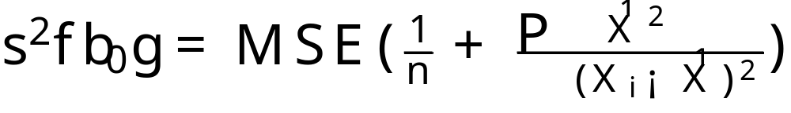
Sampling distribution of b₀
When error variance is known
When error variance is unknown

Slide 22

Confidence interval for ¯₀
The 1-® confidence limits for ¯₀ are obtained in the same manner as those for ¯₁

Slide 23
Considerations on Inferences on ¯₀ and ¯₁
Effects of departures from normality
  The estimators of ¯₀ and ¯₁ have the property of asymptotic normality – their distributions approach normality as the sample size increases (under general conditions)
Spacing of the X levels
  The variances of b₀ and b₁ (for a given n and ¾²) depend strongly on the spacing of X

Slide 24

Sampling distribution of point estimator of mean response
Let X_{h} be the level of X for which we would like an estimate of the mean response
  Needs to be one of the observed X’s
The mean response when X=X_{h} is denoted by E{Y_{h}}
The point estimator of E{Y_{h}} is
We are interested in the sampling distribution of this quantity

Slide 25

Sampling Distribution of
We have
Since this quantity is itself a linear combination of the Y_{i}’s it’s sampling distribution is itself normal.
The mean of the sampling distribution is
Biased or unbiased?

Slide 26
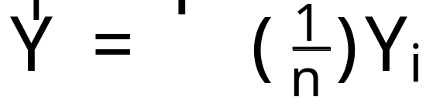
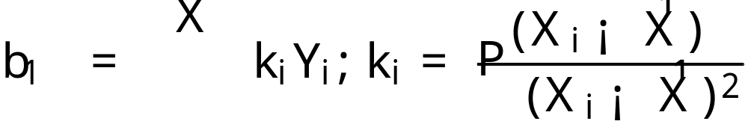
Sampling Distribution of
To derive the sampling distribution variance of the mean response we first show that b₁ and (1/n) ∑ Y_{i} are uncorrelated and, hence, for the normal error regression model independent
We start with the definitions

Slide 27
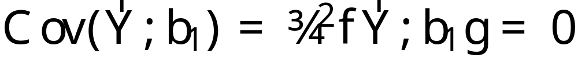
Sampling Distribution of
We want to show that mean response and the estimate b₁ are uncorrelated
To do this we need the following result (A.32)
when the Y_{i} are independent

Slide 28
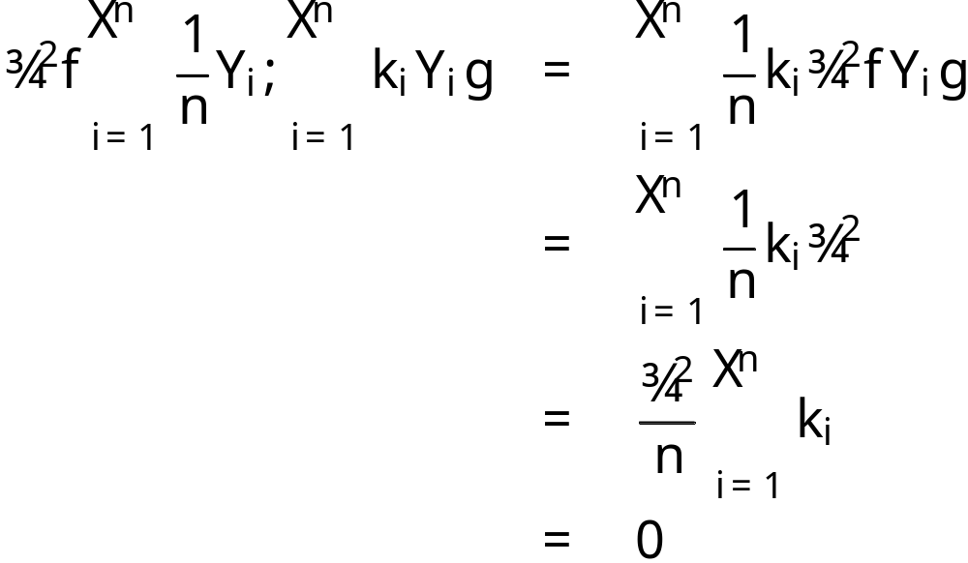

Sampling Distribution of
Using this fact we have
So the Y and b₁ are uncorrelated
from appendix

Slide 29
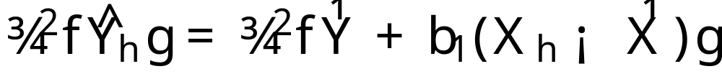
Sampling Distribution of
This means that we can write down the variance
But we know that the mean of Y and b₁ are uncorrelated so
alternative and equivalent
form of regression function

Slide 30
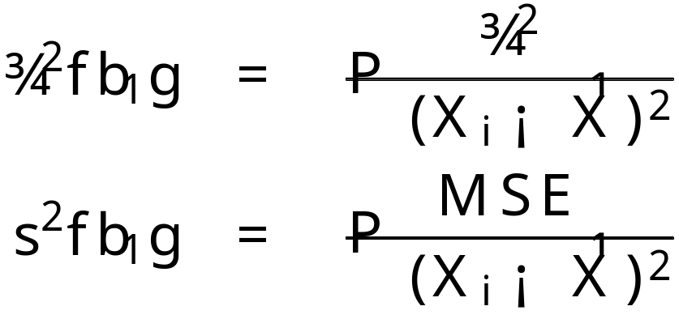
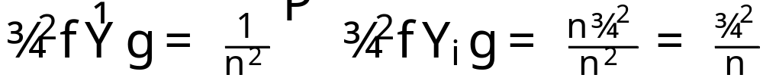
Sampling Distribution of
We know (from last lecture)
And we can find

Slide 31
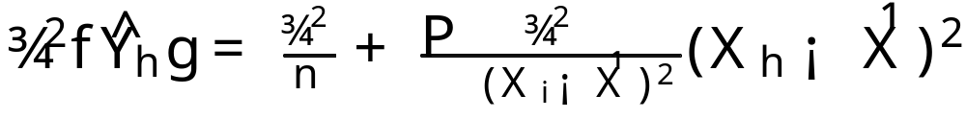
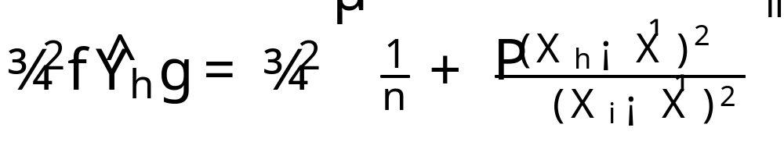
Sampling Distribution of
So, plugging in, we get
Or

Slide 32
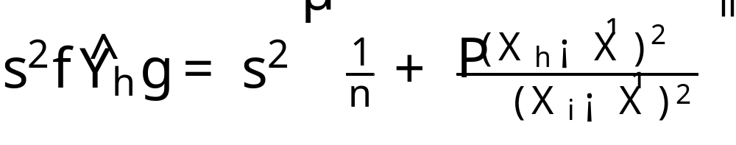
Sampling Distribution of
Since we often won’t know ¾² we can, as usual, plug in s² = SSE/(n-2), our estimate for it to get our estimate of this sampling distribution variance

Slide 33
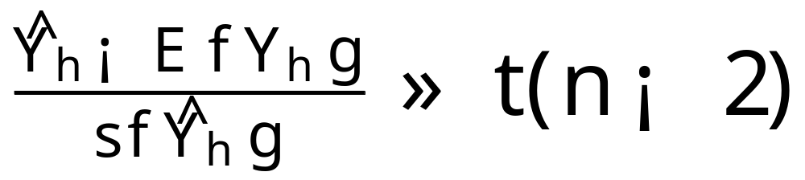
No surprise…
The sampling distribution of our point estimator for the output is distributed as a t-distribution with two degrees of freedom
This means that we can construct confidence intervals in the same manner as before.

Slide 34

Confidence Intervals for E{Y_{h}}
The 1-® confidence intervals for E{Y_{h}} are
From this hypothesis tests can be constructed as usual.

Slide 35
Comments
The variance of the estimator for E{Y_{h}} is smallest near the mean of X. Designing studies such that the mean of X is near X_{h} will improve inference precision
When X_{h} is zero the variance of the estimator fo E{Y_{h}} reduces to the variance of the estimator b₀ for ¯₀

Slide 36
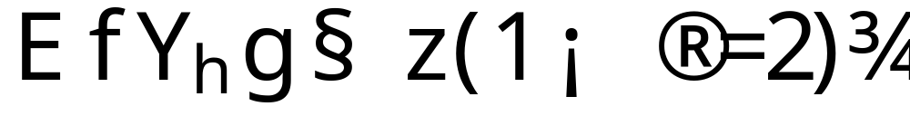
Prediction interval for single new observation
Essentially follows the sampling distribution arguments for E{Y_{h}}
If all regression parameters are known then the 1-® prediction interval for a new observation Y_{h} is

Slide 37

Prediction interval for single new observation
If the regression parameters are unknown the 1-® prediction interval for a new observation Y_{h} is given by the following theorem
This is very nearly the same as prediction for a known value of X but includes a correction for the fact that there is additional variability arising from the fact that the new input location was not used in the original estimates of b₁, b₀, and s²

Slide 38
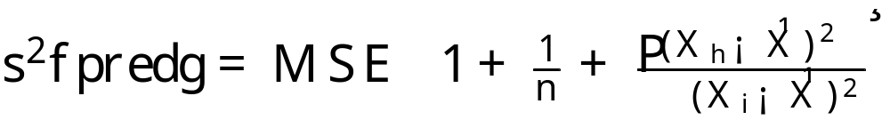
Prediction interval for single new observation
The value of s²{pred} is given by

